Slide 1
3.1.2 Differentiate MAC Address and the IP Address
Notes:
4 - Physical Layer
4.6 - Wireless Media

Slide 2
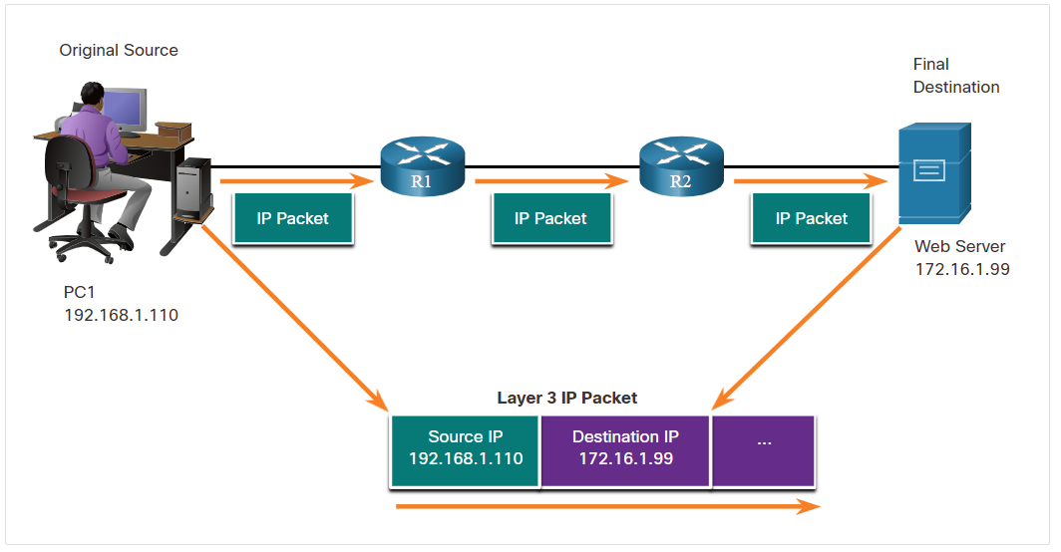
An IP address is the network layer, or Layer 3, logical address used to deliver the IP packet from the original source to the final destination, as shown in the figure.
The IP packet contains two IP addresses:
Source IP address - The IP address of the sending device, which is the original source of the packet.
Destination IP address - The IP address of the receiving device, which is the final destination of the packet.
The IP addresses indicate the original source IP address and final destination IP address. This is true whether the source and destination are on the same IP network or different IP networks.
An IP address contains two parts:
Network portion (IPv4) or Prefix (IPv6) - The left-most part of the address that indicates the network in which the IP address is a member. All devices on the same network will have the same network portion of the address.
Host portion (IPv4) or Interface ID (IPv6) - The remaining part of the address that identifies a specific device on the network. This portion is unique for each device or interface on the network.

Slide 3
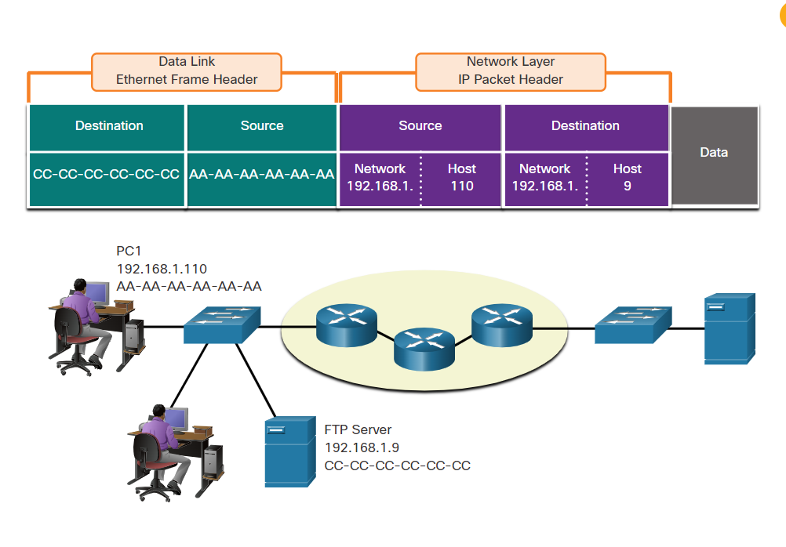
Devices on the Same Network
In this example we have a client computer, PC1, communicating with an FTP server on the same IP network.
Source IPv4 address - The IPv4 address of the sending device, the client computer PC1: 192.168.1.110.
Destination IPv4 address - The IPv4 address of the receiving device, FTP server: 192.168.1.9.
Notice in the figure that the network portion of the source IPv4 address and the network portion of the destination IPv4 address are the same and therefore; the source and destination are on the same network.

Slide 4
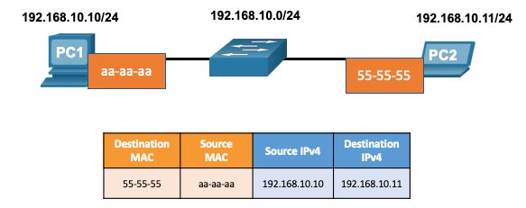
MAC and IP
Destination on Same Network
There are two primary addresses assigned to a device on an Ethernet LAN:
  Layer 2 physical address (the MAC address) – Used for NIC to NIC communications on the same Ethernet network.
  Layer 3 logical address (the IP address) – Used to send the packet from the source device to the destination device.
  Layer 2 addresses are used to deliver frames from one NIC to another NIC on the same network. If a destination IP address is on the same network, the destination MAC address will be that of the destination device.
Notes:
9 – Address Resolution
9.1 – MAC and IP
9.1.1 – Destination on Same Network

Slide 5
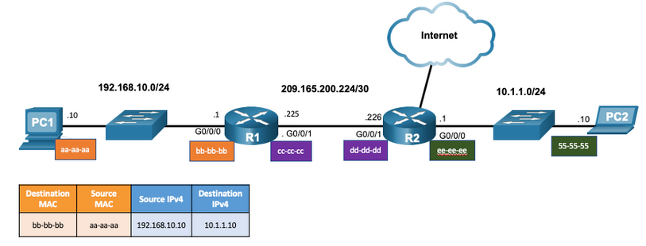
MAC and IP
Destination on Remote Network
When the destination IP address is on a remote network, the destination MAC address is that of the default gateway.
  ARP is used by IPv4 to associate the IPv4 address of a device with the MAC address of the device NIC.
  ICMPv6 is used by IPv6 to associate the IPv6 address of a device with the MAC address of the device NIC.
Notes:
9 – Address Resolution
9.1 – MAC and IP
9.1.2 – Destination on Remote Network

Slide 6
Module Objectives
Module Title: Ethernet and ARP
Module Objective:
Explain how Ethernet works
Explain how ARP and ND enable communication on a network.
Topic Title | Topic Objective
Ethernet Frame | Explain how the Ethernet sublayers are related to the frame fields.
ARP | Describe the purpose of ARP.
Neighbor Discovery | Describe the operation of IPv6 neighbor discovery.
Notes:
6
9 - Address Resolution
9.0.2

Slide 7
Ethernet and ARP
Introduction to Networks v7.0
Notes:
Cisco Networking Academy Program
Introduction to Networks v7.0 (ITN)
Module 9: Address Resolution

Slide 8
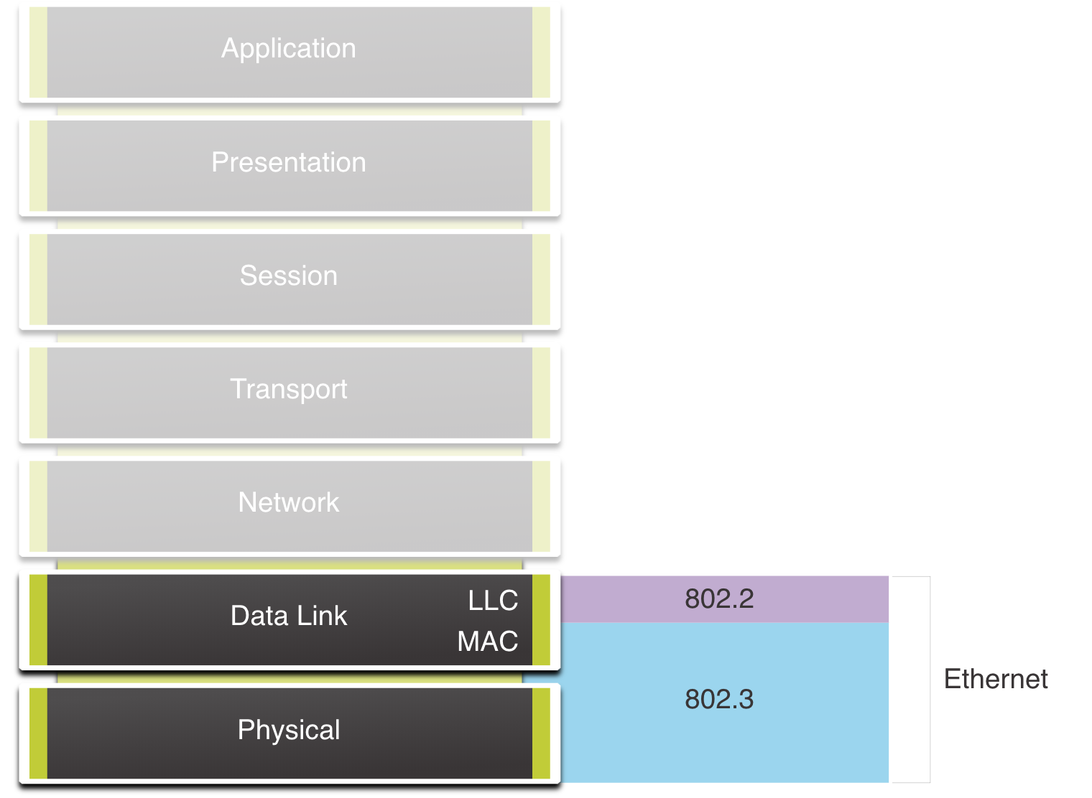
Ethernet Frames
Ethernet Encapsulation
Ethernet operates in the data link layer and the physical layer.
It is a family of networking technologies defined in the IEEE 802.2 and 802.3 standards.
Notes:
7 – Ethernet Switching
7.1 – Ethernet Frames
7.1.1 – Ethernet Encapsulation

Slide 9
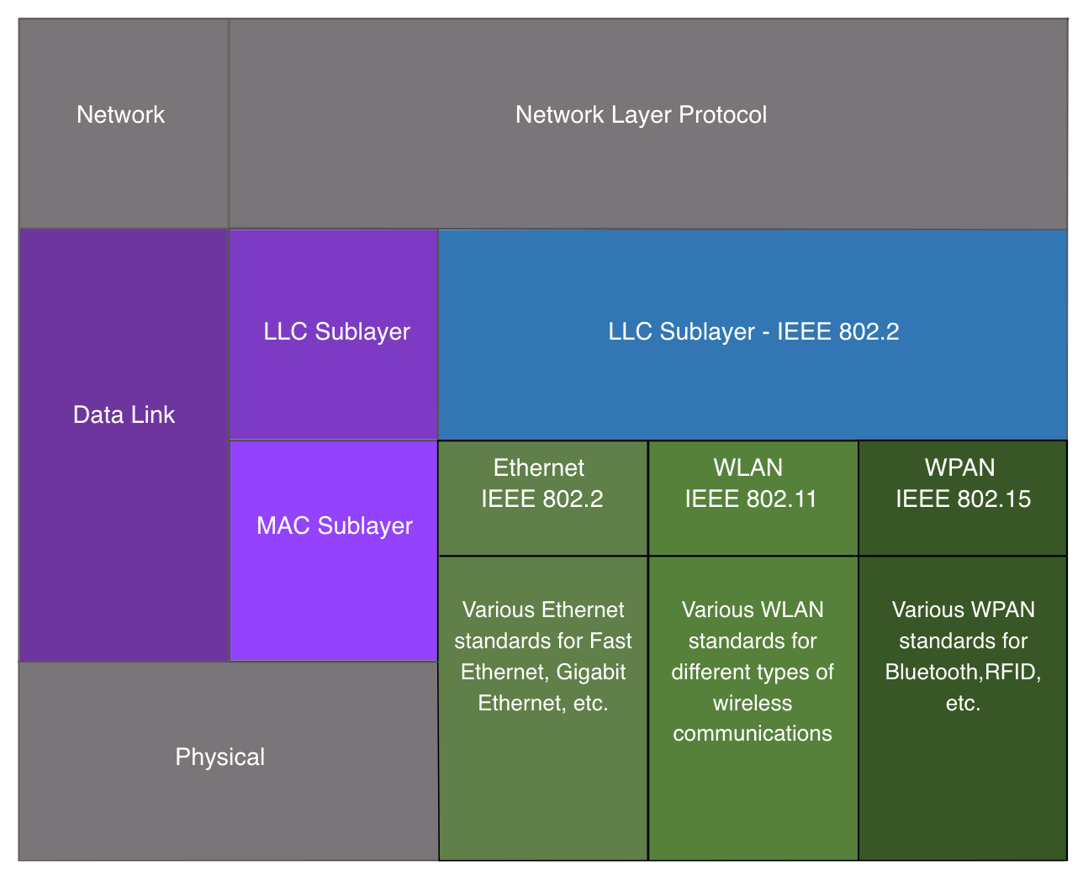
Ethernet Frames
Data Link Sublayers
The 802 LAN/MAN standards, including Ethernet, use two separate sublayers of the data link layer to operate:
LLC Sublayer: (IEEE 802.2) Places information in the frame to identify which network layer protocol is used for the frame.
MAC Sublayer: (IEEE 802.3, 802.11, or 802.15) Responsible for data encapsulation and media access control, and provides data link layer addressing.
Notes:
7 – Ethernet Switching
7.1 – Ethernet Frames
7.1.2 - Data Link Sublayers

Slide 10
Ethernet Frames
MAC Sublayer
The MAC sublayer is responsible for data encapsulation and accessing the media.
Data Encapsulation
IEEE 802.3 data encapsulation includes the following:
Ethernet frame - This is the internal structure of the Ethernet frame.
Ethernet Addressing - The Ethernet frame includes both a source and destination MAC address to deliver the Ethernet frame from Ethernet NIC to Ethernet NIC on the same LAN.
Ethernet Error detection - The Ethernet frame includes a frame check sequence (FCS) trailer used for error detection.
Notes:
7 – Ethernet Switching
7.1 – Ethernet Frames
7.1.3 – MAC Sublayer

Slide 11
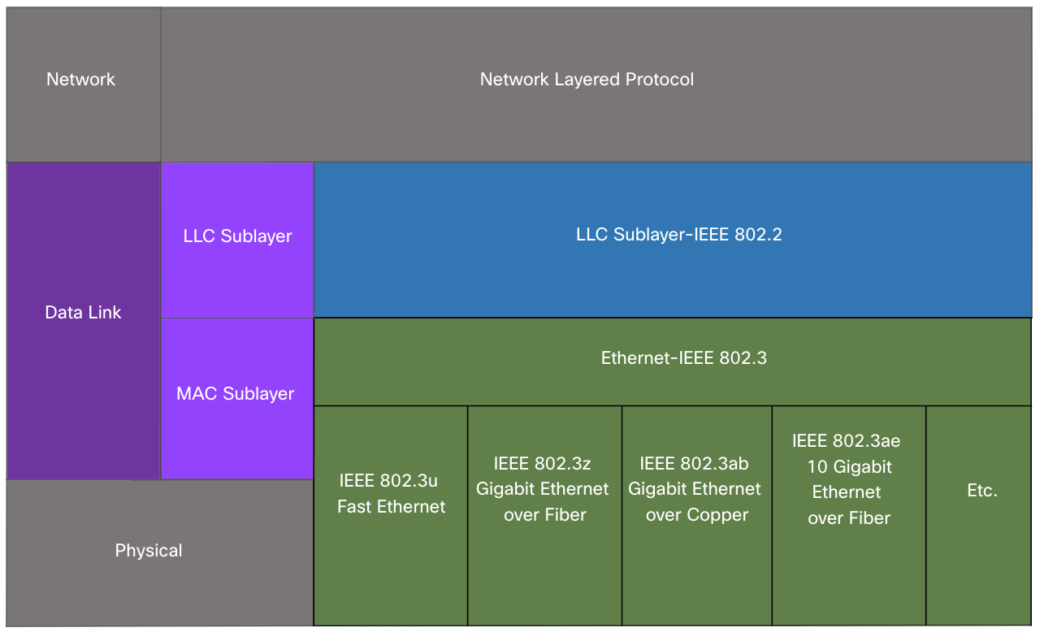
Ethernet Frames
MAC Sublayer
Media Access
The IEEE 802.3 MAC sublayer includes the specifications for different Ethernet communications standards over various types of media including copper and fiber.
Legacy Ethernet using a bus topology or hubs, is a shared, half-duplex medium. Ethernet over a half-duplex medium uses a contention-based access method, carrier sense multiple access/collision detection (CSMA/CD).
Ethernet LANs of today use switches that operate in full-duplex. Full-duplex communications with Ethernet switches do not require access control through CSMA/CD.
Notes:
7 – Ethernet Switching
7.1 – Ethernet Frames
7.1.3 – MAC Sublayer

Slide 12
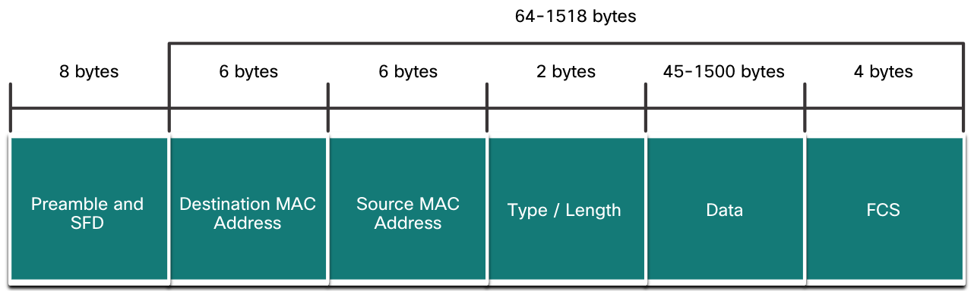
Ethernet Frames
Ethernet Frame Fields
The minimum Ethernet frame size is 64 bytes and the maximum is 1518 bytes. The preamble field is not included when describing the size of the frame.
Any frame less than 64 bytes in length is considered a “collision fragment” or “runt frame” and is automatically discarded. Frames with more than 1500 bytes of data are considered “jumbo” or “baby giant frames”.
If the size of a transmitted frame is less than the minimum, or greater than the maximum, the receiving device drops the frame. Dropped frames are likely to be the result of collisions or other unwanted signals. They are considered invalid. Jumbo frames are usually supported by most Fast Ethernet and Gigabit Ethernet switches and NICs.
Notes:
7 – Ethernet Switching
7.1 – Ethernet Frames
7.1.4 – Ethernet Frame Fields
7.1.5 – Check Your Understanding – Ethernet Switching

Slide 13
3.13 ARP
Notes:
9 - Address Resolution
9.2 ARP

Slide 14
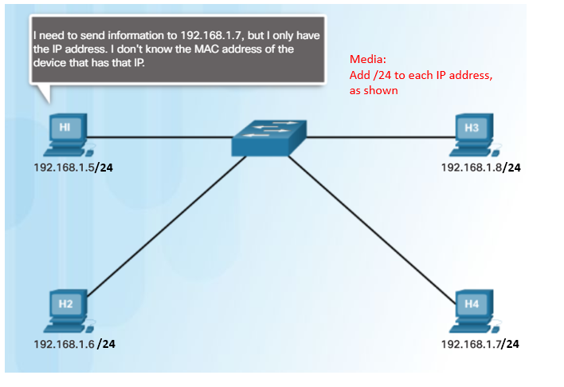
ARP
ARP Overview
A device uses ARP to determine the destination MAC address of a local device when it knows its IPv4 address.
ARP provides two basic functions:
  Resolving IPv4 addresses to MAC addresses
  Maintaining an ARP table of IPv4 to MAC address mappings
Notes:
9 – Address Resolution
9.2 – ARP
9.2.1 – ARP Overview

Slide 15
ARP
ARP Functions
To send a frame, a device will search its ARP table for a destination IPv4 address and a corresponding MAC address.
  If the packet’s destination IPv4 address is on the same network, the device will search the ARP table for the destination IPv4 address.
  If the destination IPv4 address is on a different network, the device will search the ARP table for the IPv4 address of the default gateway.
  If the device locates the IPv4 address, its corresponding MAC address is used as the destination MAC address in the frame.
  If there is no ARP table entry is found, then the device sends an ARP request.
Notes:
9 – Address Resolution
9.2 – ARP
9.2.2 – ARP Functions

Slide 16
ARP
Video - ARP Request
This video will cover an ARP request for a MAC address.
Notes:
9 – Address Resolution
9.2 – ARP
9.2.3 – Video - ARP Request

Slide 17
ARP
Video – ARP Operation - ARP Reply
This video will cover an ARP reply in response to an ARP request.
Notes:
9 – Address Resolution
9.2 – ARP
9.2.4 – Video – ARP Operation - ARP Reply

Slide 18
ARP
Video - ARP Role in Remote Communications
This video will cover how an ARP request will provide a host the MAC address of the default gateway.
Notes:
9 – Address Resolution
9.2 – ARP
9.2.5 – Video - ARP Role in Remote Communications

Slide 19
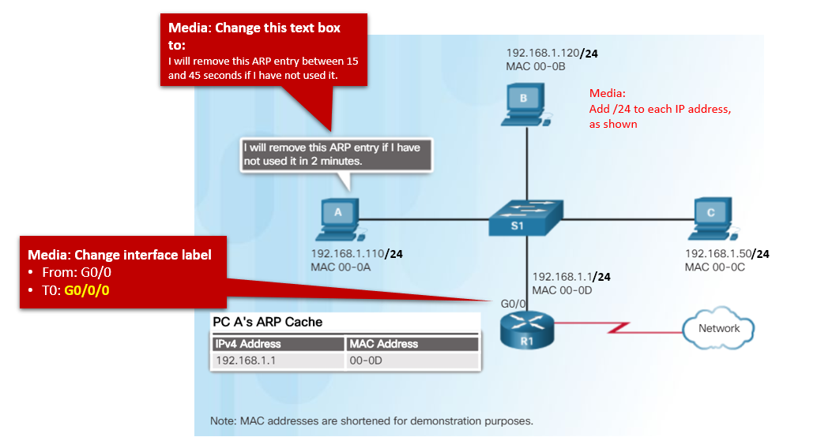
ARP
Removing Entries from an ARP Table
Entries in the ARP table are not permanent and are removed when an ARP cache timer expires after a specified period of time.
The duration of the ARP cache timer differs depending on the operating system.
ARP table entries can also be removed manually by the administrator.
Notes:
9 – Address Resolution
9.2 – ARP
9.2.6– Removing Entries from an ARP Table

Slide 20
ARP
ARP Tables on Networking Devices
The show ip arp command displays the ARP table on a Cisco router.
The arp –a command displays the ARP table on a Windows 10 PC.
R1# show ip arp
Protocol Address Age (min) Hardware Addr Type Interface
Internet 192.168.10.1 - a0e0.af0d.e140 ARPA GigabitEthernet0/0/0
C:\Users\PC> arp -a
Interface: 192.168.1.124 --- 0x10
Internet Address Physical Address Type
192.168.1.1 c8-d7-19-cc-a0-86 dynamic
192.168.1.101 08-3e-0c-f5-f7-77 dynamic
Notes:
9 – Address Resolution
9.2 – ARP
9.2.7 – ARP Tables on Networking Devices

Slide 21
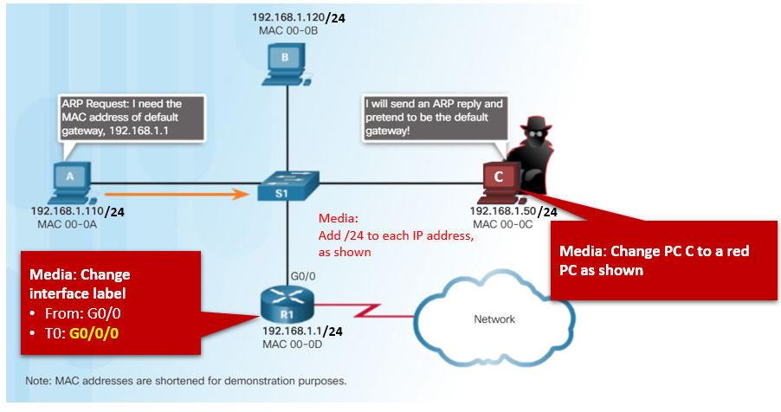
ARP
ARP Issues – ARP Broadcasting and ARP Spoofing
ARP requests are received and processed by every device on the local network.
Excessive ARP broadcasts can cause some reduction in performance.
ARP replies can be spoofed by a threat actor to perform an ARP poisoning attack.
Enterprise level switches include mitigation techniques to protect against ARP attacks.
Notes:
9 – Address Resolution
9.2 – ARP
9.2.8 – ARP Issues – ARP Broadcast and ARP Spoofing

